Slide 1
Program Adaptation
Cam Escoffery, PhD, MPH
Assistant Professor
Michelle Carvalho, MPH, CHES
Team Lead/Project Director
Prevention Research Center/Cancer Prevention & Control Research Network
Rollins School of Public Health, Emory University

Slide 2
Session Agenda
Program Adaptation and Fidelity Overview
Program Adaptation – Examples
Resources
Case Studies from R2R – Charlene and Venice

Slide 3


Adapting Evidence-based Approaches for Communities
April 25, 2012 – National Cancer Institute
Research to Reality Mentorship Program
Michelle Carvalho, MPH, CHES
Cam Escoffery, PhD, MPH, CHES
Emory University – Rollins School of Public Health

Slide 4
Presentation Objectives
Define fidelity and adaptation;
Discuss how to consider program fit/compatibility with audiences, organizations and communities; and
Describe evidence-based program components that can and cannot be adapted (e.g., core elements, fidelity to original program).

Slide 5

Adapting Evidence-Based Programs to Fit Community Needs

Slide 6
Program Fidelity
Fidelity: “faithfulness” to the implementation of program elements in the way they were intended to be delivered in the original intervention
Core elements*: required components that represent the theory and internal logic of the intervention and most likely produce the intervention’s effectiveness
Key process steps: required implementation or program delivery steps that are conducted to contribute to the intervention’s effectiveness
*Eke, Neumann, Wilkes, Jones. Preparing effective behavioral interventions to be used by prevention providers: the role of researchers during HIV Prevention Research Trials. AIDS Education & Prevention 2006, 18(4 Suppl A):44-58.

Slide 7
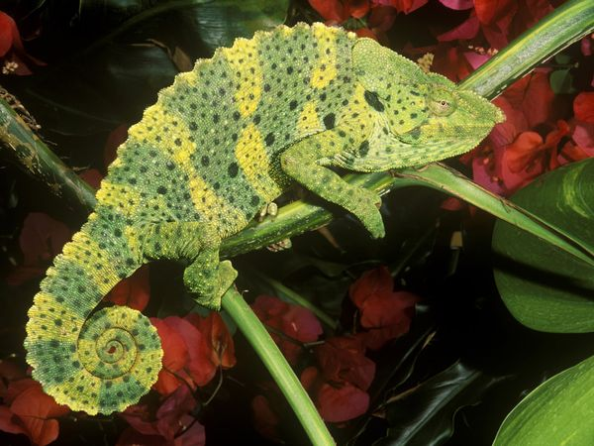
Adaptation is…
…making
Changes
Additions
Deletions
Substitutions
to an evidence-based intervention in order to make it more suitable for a particular population and/or an organization’s capacity.

Slide 8
Fit Considerations
Strategy/ Program/Policy
Health behaviors/topics
Goals
Type of delivery methods
Time span
Setting
Audience
Age
Education
Gender
Race/ethnicity
Socioeconomic status
Organization
Fit with mission
Leadership support
Availability of a project coordinator
Resources
Finances/cost
Staff & expertise
Facilities
Partnerships
Community
Priorities and values
Readiness for prevention
Fit with other programs

Slide 9

Core Content Components
WHAT is being taught in the program?
Knowledge about importance of physical activity
Self-efficacy to prepare healthy meals or snacks
Social support (family) for healthy eating
Adapted from: Lesesne, C. A., Lewis, K. M., Moore, C., Fisher, D., Green, D., & Wandersman, A. (2007). Promoting Science-based Approaches to Teen Pregnancy Prevention using Getting To Outcomes: Draft June 2007. Unpublished manual.
Notes:
[Background – Core elements]

Slide 10
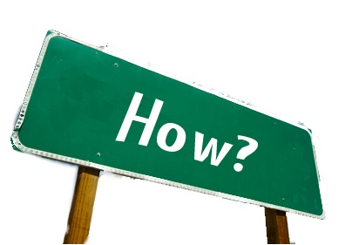
Core Pedagogical Components
HOW is that content being taught?
Demonstrations
Large group discussions
Videos
Fitness activities
Notes:
[Background – Core elements]

Slide 11

Core Implementation Components
What are the necessary LOGISTICS?
Type of program deliverer or implementer(s) (e.g., nutritionist, lay health advisor)
Setting
Sequence of activities
Notes:
[Background – Core elements]

Slide 12
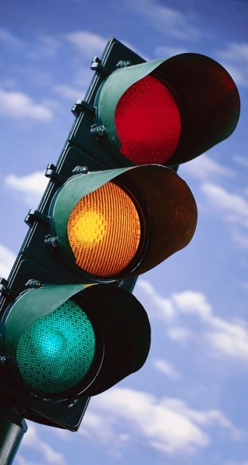
Adaptation Guidance Tool
Green light
Things that can be changed
Yellow light
Things that can be changed with caution
Red light
Things that cannot be changed

Slide 13

Things That Can Probably Be Modified
Names of health care centers or systems
Pictures of people and places and quotes
Hard-to-read words that affect reading level
Wording to be appropriate to audience
Ways to recruit your audience
Incentives for participation
Timeline (based on adaptation guides)
Cultural preferences based on population

Slide 14

Things That Can Probably Be Modified BUT Proceed with Caution
Substituting activities
Modifying who delivers the program
Changing the order of the curriculum or steps (sequence)
Altering the length of program activities
Varying the primary audience
Changing delivery format/process steps
Adding activities to address other risk factors or behaviors

Slide 15
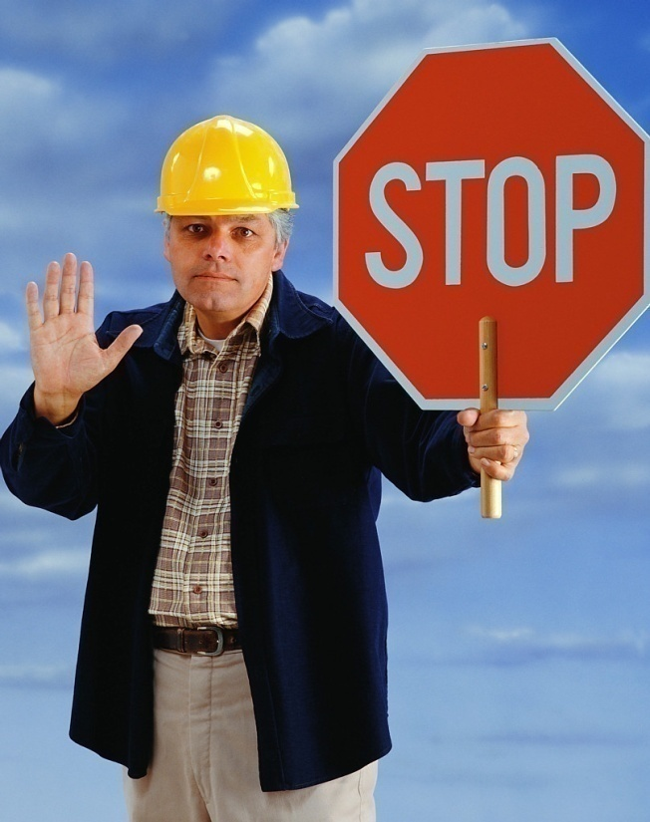
Things That Cannot Be Modified
The health communication model or theory
The health topic/behavior
Deleting core elements or whole sections of the program
Reduction in
Timeline (beyond adaptation guidelines)
Dosage (e.g., activities, time/session)
Putting in activities that detract from the core elements
Adapted from: Lesesne, C. A., Lewis, K. M., Moore, C., Fisher, D., Green, D., & Wandersman, A. (2007). Promoting Science-based Approaches to Teen Pregnancy Prevention using Getting To Outcomes: Draft June 2007. Unpublished manual.
Notes:
Will you use stop light here, too? I like the big stop sign. Really noticed!

Slide 16
Fidelity-Adaptation Continuum
HIGH
FIDELITY
MINOR
ADAPTATION
E
V
A
L
U
A
T
I
O
N
LOW
FIDELITY
MAJOR ADAPTATION
NEED

Slide 17
The Adaptation Process
Start with:
Seek Assistance from:
Review all program materials
Program protocol or implementation guide
Program core elements listing
Consider the new audience
Needs assessment data
Determinants that affect their behavior or environment
Program materials – Is there adaptation guidance?
Program developers
Discuss core components
Ideas about potential changes

Slide 18
Steps for Adaptation
Determine the needs of your audience and whether this program addresses those needs
Review the program and its materials with your intended audience for feedback on its appropriateness
Define the extent of adaptation needed and potential ways to implement the new program
Develop “mock-up” versions of the adapted products
Work with expert advisors to ensure that the adapted products maintain the accuracy of the originals
Source: Research-tested Interventions Programs (RTIPS). Guidelines for Choosing and Adapting Programs. http://rtips.cancer.gov/rtips/faq.do.

Slide 19

Steps for Adaptation (cont.)
Pilot test the adaptation with representatives from your audience.
Modify or revise the adapted program and products based on pilot test feedback.
Implement the program.
Evaluate the effectiveness of your adapted program and products.
Source: Research-tested Interventions Programs (RTIPS). Guidelines for Choosing and Adapting Programs. http://rtips.cancer.gov/rtips/faq.do.
Notes:
Need to highlight in green the key verbs in 8 & 9.

Slide 20
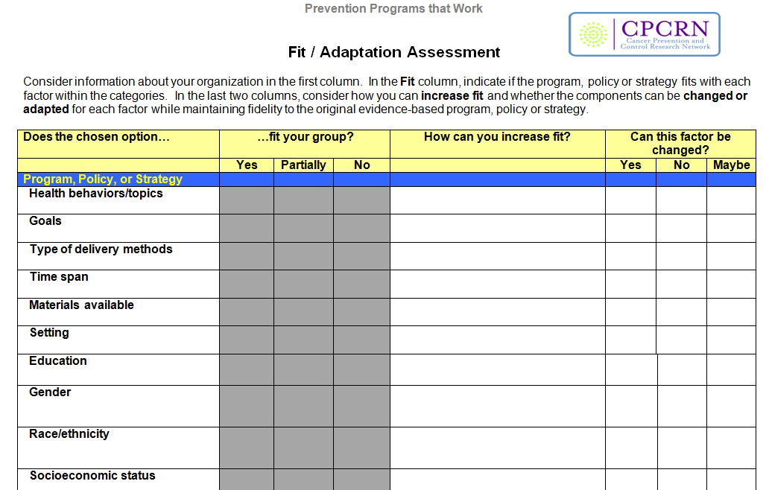
Adaptation Worksheet
Tools Adapted from: Lesesne, C. A., Lewis, K. M., Moore, C., Fisher, D., Green, D., & Wandersman, A. (2007). Promoting Science-based Approaches to Teen Pregnancy Prevention using Getting To Outcomes: Draft June 2007. Unpublished manual.

Slide 21
Group Activity: Program Materials Adaptation

Slide 22
Materials Adaptation Group Activity
Assignment:
Review the intervention materials:
Eat for Life Cookbook (designed for African American churches)
Stairwell to Better Health signs (use in medium-sized work sites)
Think about the community where you work. For your audience and/or setting:
Decide what you can change in the material to better reach your audience
Decide what you cannot change
Share about the decision-making process of adaptation
Notes:
Hidden for internal instruction
Half room looks at Cookbook
Half room looks at Stairwell

Slide 23
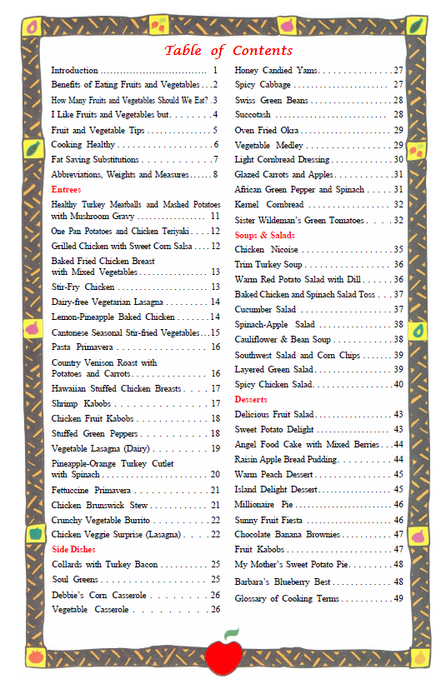

Slide 24
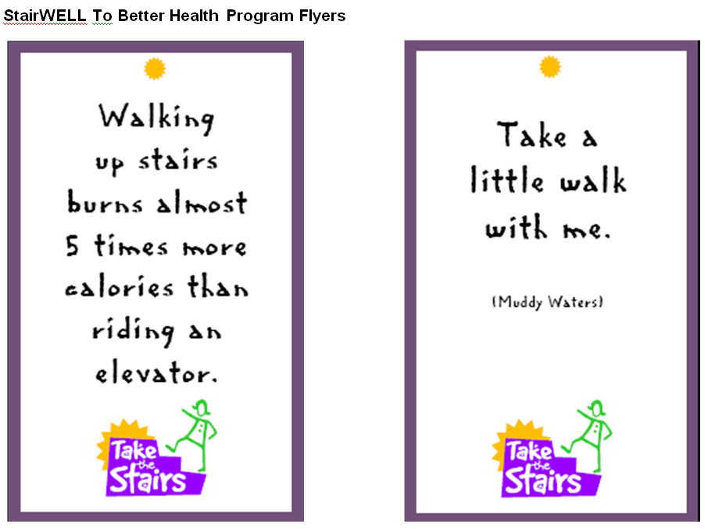

Slide 25
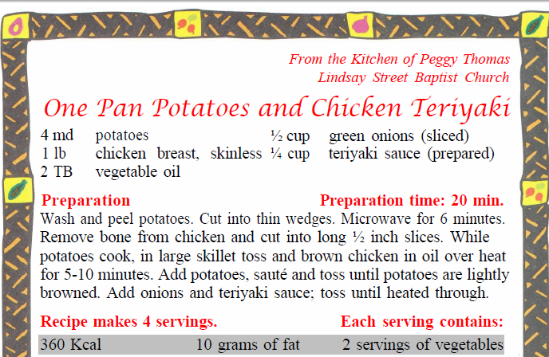
Potential Adaptation Examples
Eat for Life Cookbook
Green Light:
Making the font larger
Redesigning the cover to fit the congregation’s culture
Yellow Light:
Adding recipes from a local cooking contest (need nutritionist/expert consultation)
Red Light:
Adding recipes that are not evaluated healthy options
Adding dieting tips that may not be evidence-based

Slide 26
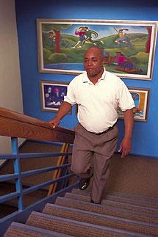
Potential Adaptation Examples
Stairwell to Better Health
Green Light:
Modifying quotes/lyrics on signs
Updating graphics, font, visual design
Other stairwell enhancements (music, aesthetics, etc.)
Yellow Light:
Adding new statistics (need to verify if credible)
Red Light:
Changing message to promote other behaviors like healthy eating, smoking cessation, etc.

Slide 27
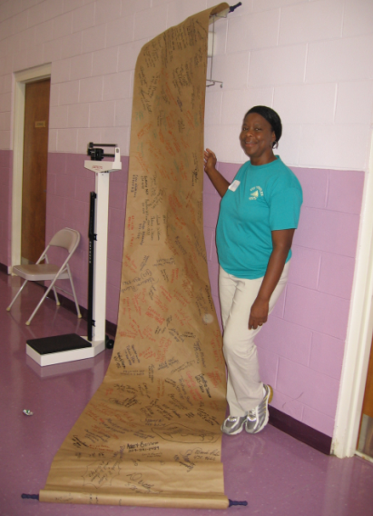
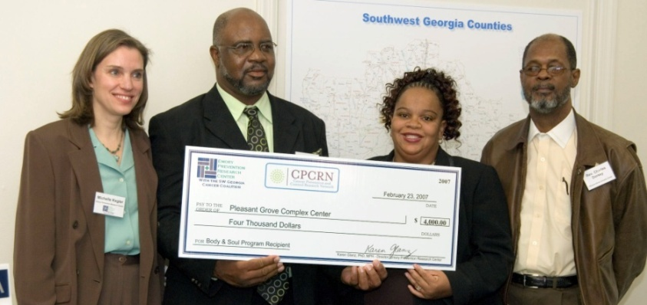
Emory Mini-grants Program to Disseminate Evidence-based Programs
A “push-pull method” (i.e. funds + TA) increases
demand while building capacity*
3 cohorts: 2007-2012 (12-24 month period)
16 SW GA community organizations awarded
Received $3500-$8000 & technical assistance (TA)
Implemented 7 RTIPs programs (nutrition, physical activity, & tobacco use prevention)
* Green LW, Orleans T, Ottoson JM, Cameron R, Pierce JP, Bettinghaus EP. Inferring strategies for disseminating physical activity policies, programs, and practices from the successes of tobacco control. Am J Prev Med. 2006;31(4)(suppl):S66–S81.

Slide 28
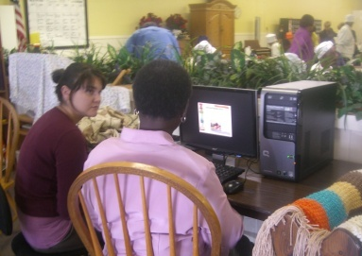
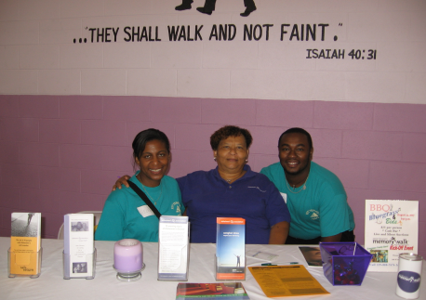
16 Awarded Sites & 7 Programs
16 Funded Organizations in Georgia | 7 Evidence-Based Programs
4 Churches | Body and Soul - nutrition
5 Worksites | Treatwell 5-A-Day - nutrition
2 Community Coalitions | Parents as Teachers (PAT) High 5 Low Fat Program - nutrition
Senior Center | Little By Little Nutrition Program
Hospital Diabetes Management Center | Patient-Centered Assessment & Counseling for Exercise (PACE)
County School System & Community Outreach Organization | Coordinated Approach to Child Health (CATCH) – nutrition and physical activity
Community Outreach Organization | Family Matters – tobacco use prevention

Slide 29
Types of Adaptation
Five major types of adaptations were observed:
Changing/modifying :
educational materials,
intended audience, and
program delivery;
Adding new activities; and
Deleting core elements.

Slide 30
Fidelity-Adaptation Continuum
HIGH
FIDELITY
ADAPTATION EXAMPLES
MINOR
ADAPTATION
Added/customized materials
Added activities
Shifted primary audience
Held concurrent physical activity
& weight loss events
Changed delivery format/process steps
Expanded audience (to community)
Shifted focus to other behaviors
Did not complete all core elements
NEEDS EVALUATION
LOW
FIDELITY
MAJOR ADAPTATION

Slide 31
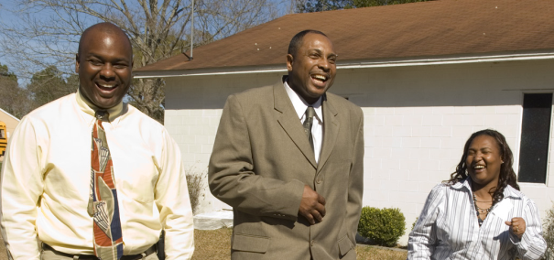
Adaptation Quotes
Expanded the program from worksite/coalition to the community
“This project seems to have opened the door for a brand new [obesity] issue that our county had not talked about…all of a sudden the light went on …[the collaborative] said we need to add this to our benchmarks as a group and start working on this.” - Site coordinator
Added physical activity & weight loss events (to nutrition program)
“Because of the nutrition part of it, people began to feel better and they had more energy. So they was able to do more physical activities and wanted to do more as far as looking at weight loss…” - Site coordinator
Deleted a core element
“They thought that if we had some type of [party or family] event, [employees] would be saying, “Now you’re asking me to take unemployment weeks, but...you’re having an event.” – Site coordinator

Slide 32
Reasons for Adaptations
Sites had intentional or unintentional reasons for making program adaptations including:
Enhancing engagement in the program,
Reaching specific audiences,
Increasing program fit, and
Reinforcing program messages.
Reasons for not completing core elements
(program deletions) included
Various types of “turbulence” or competing demands (e.g. leadership/staff transitions and time constraints)

Slide 33
Reasons for Adaptations - Quotes
Added content to reach specific audiences (teen parents)
“You got to think about being also sensitive to the age of the parent. If you have [a parent] that’s maybe 14…give them something that can be kinda fun…” - Site coordinator
Integrated program components into pre-existing activities to increase program fit with the organization
“ [There are] other events that we already have annually and that we just incorporated with the program, we just thought it would just be a good idea just to bring them, you know, merge the two together.” – Site coordinator

Slide 34
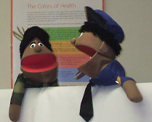
A Tale of 4 Sites…
Body & Soul/Church: Minimal Adaptation
Minor additions (incentives & activities)
Body & Soul/Church: Major Adaptation
Shifted focus to physical activity/weight loss
Little by Little/Senior Center:
Intermediate-Major Adaptation
Assisted delivery of CD-ROM & added activities
Treatwell 5-a-Day/CBO: Major Adaptation
Shifted audience to Advisory Board, then community
Newsletters → monthly local newspaper stories

Slide 35
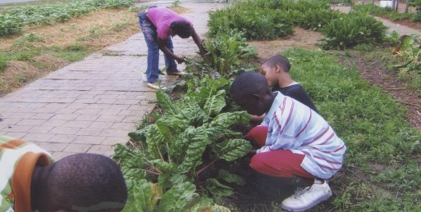
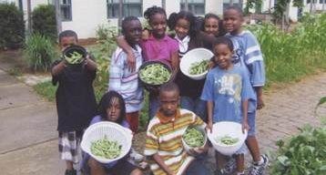
Key Findings & Implications for Practice
9 of 12 (75%) past mini-grant sites conducted all core elements
95% of core elements were conducted across all 12 sites
Mini-grants, training and technical assistance are promising strategies to translate evidence into community practice
More evaluation is needed to determine how best to adapt and implement evidence-based programs with fidelity

Slide 36
Related Products
Hannon, P. A., Fernandez, M. E., Williams, R. S., Mullen, P. D., Escoffery, C., Kreuter, M.W., Pfeiffer, D., Kegler, M.C., Reese, L., Mistry, R., Bowen, D. J. (2010). Cancer control planners' perceptions and use of evidence-based programs. Journal of Public Health Management and Practice, 16(3), E1-8.
Honeycutt, S., Carvalho, M., Daniel, S. D., Glanz, K., & Kegler, M. C. Research to reality: A process evaluation of a mini-grants program to disseminate evidence-based nutrition interventions to rural churches and worksites. Journal of Public Health Management and Practice. In press.
Escoffery C, Carvalho M, Kegler M. Evaluation of the “Prevention Programs that Work” Curriculum to Teach Use of Public Health Evidence to Community Practitioners. Health Promotion Practice. In press.
Notes:
Hannon paper 220 respondents surveyed

Slide 37

Key Presentation Points
Evidence-based programs can be strategically adapted to increase fit with your audience, organization, or community context.
When making adaptations you should try to stay faithful to the core elements of the original program.
If you make many adaptations then you may need to conduct outcome evaluation to see the effects of the modified program.

Slide 38
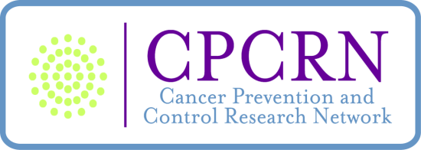
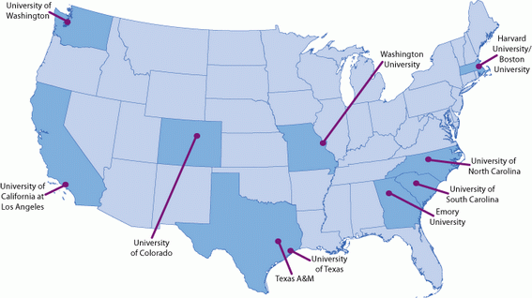
Network Center Map Mission: To accelerate the adoption of evidence-based cancer prevention and control in communities.
www.cpcrn.org

Slide 39
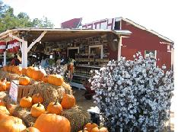
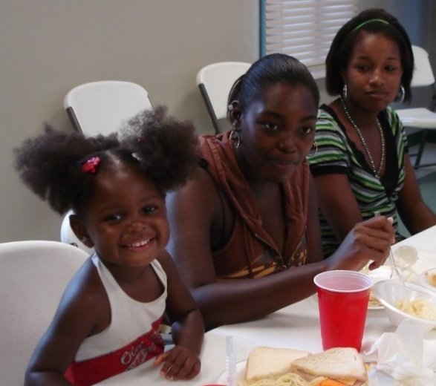

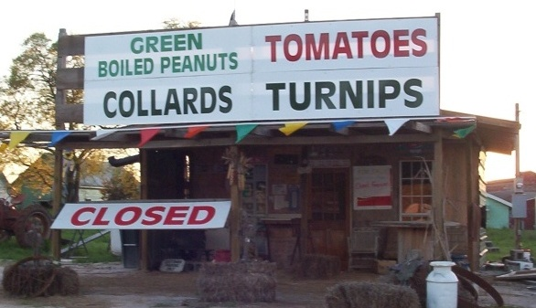
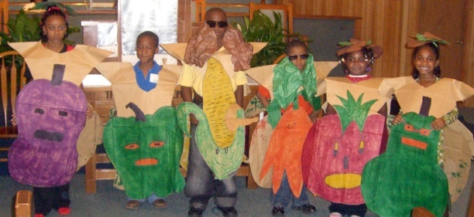
QUESTIONS? Michelle Carvalho mlcarva@emory.edu Cam Escoffery cescoff@emory.edu
The CPCRN is part of the Prevention Research Centers Program. It is supported by the Centers for Disease Control and Prevention and the National Cancer Institute (Cooperative agreement # 1U48DP0010909-01-1)

